Slide 1
Conference Realignment - Impact on College Athletics Programs

Slide 2
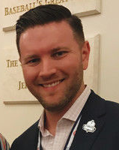
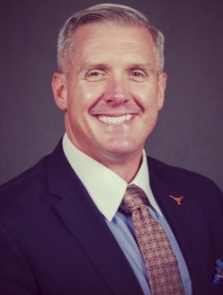
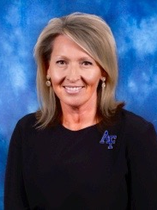
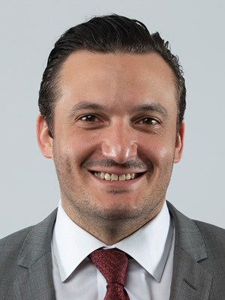
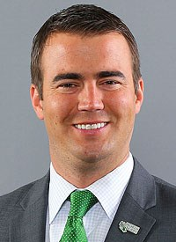
Eric McKenzie
Drew Martin
Nancy Hixon
Anthony Di Fino
Ryan Peck
Paciolan
University of Texas
Air Force Academy
University of Cincinnati
North Texas University

Slide 3
EVALUATING CHANGE
COMMUNICATION
IMPACT

Slide 4
EVALUATING CHANGE
COMMUNICATION
IMPACT

Slide 5

OPERATION SEC TRANSITION
Sport Programs/Team Operations
Competition comparative evaluation, Roster sizes, Recruiting, Equipment, Scheduling philosophy
Student-Athlete Experience/Academics/Compliance/4EVERTEXAS
Admissions, Eligibility, DIEP, Title IX, NIL
Sports Medicine/Behavioral Health/Strength & Conditioning/Applied Science/Nutrition
Facilities/Equipment, Evaluation of SEC sports medicine policies and procedures including drug testing
Travel
Conference and non-conference competition evaluation, Recruiting – on and off campus
Finances/Budget/HR
Departmental and sport budget evaluation, headcount and compensation structures
Facilities & IT/AV
Sport competition and practice facilities, Departmental and sport support facilities, Major capital projects in progress
Development
Development philosophy, Donor and Annual Fund numbers, Premium seating, donor experiences, University engagement
Game & Event Management
Organizational & staffing structure, Inside & outside of venue fan experience, Parking
Ticket Sales & Operations
Competition facilities capacity, season ticket numbers & pricing, Evaluation of SEC ticket policies, visiting team allocations/locations
External Operations
Marketing & Advertising
Fan Engagement/Experience/Traditions/Band/Spirit
Trademark & Licensing
Learfield/Sponsorships/Multimedia Rights/Radio Network/Online Audio/Livestreaming and Live Event Production for Linear Channel
Food and Beverage Operations
Creative/Digital/Mobile/Social Media
Media Relations & Communications
Television
ESPN/SEC network, UT content rights/obligations – facilities/equipment
Branding- SEC Rebrand
Marketing/Adverting/Media/Communications/Facilities

Slide 6
OPERATION SEC TRANSITION
Goal
  To give each Texas Athletics employee an opportunity to participate on at least one committee, provide input and have a vested interest in the process.
Committee Participation
  Sport Programs/Team Operations – 18 committee members
  Student-Athlete Experience/Academics/Compliance/4EVERTEXAS – 19 committee members
  Sports Medicine/Behavioral Health/Strength & Conditioning/Applied Science/Nutrition - 25 committee members
  Travel - 15 committee members
  Finances/Budget/HR - 15 committee members
  Facilities & IT/AV - 17 committee members
  Development - 11 committee members
  Game & Event Management - 14 committee members
  Ticket Sales & Operations - 12 committee members
  External Operations - 55 committee & sub-committee members
  Television - 11 committee members
  Branding- SEC Rebrand - 10 committee members
Meetings
  Committee’s meet once a month

Slide 7
EVALUATING CHANGE
COMMUNICATION
IMPACT

Slide 8
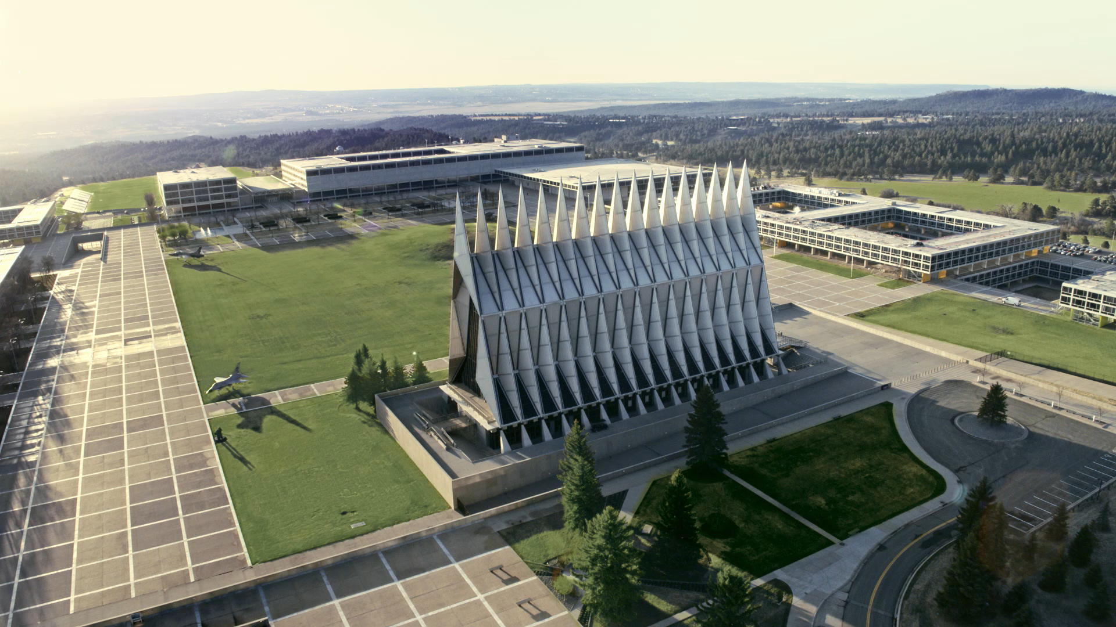

Slide 9
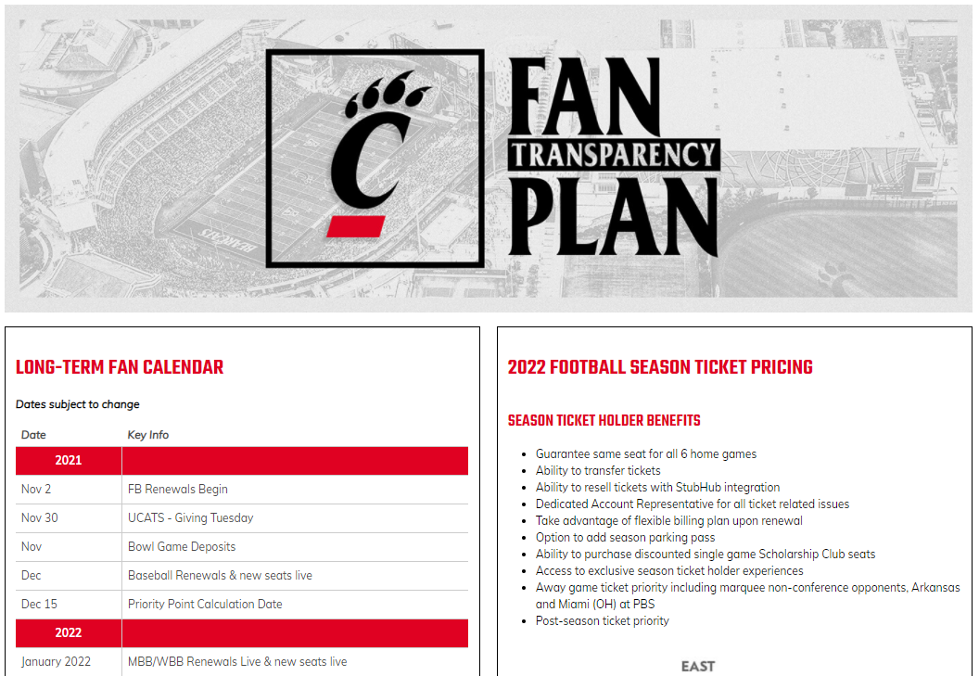

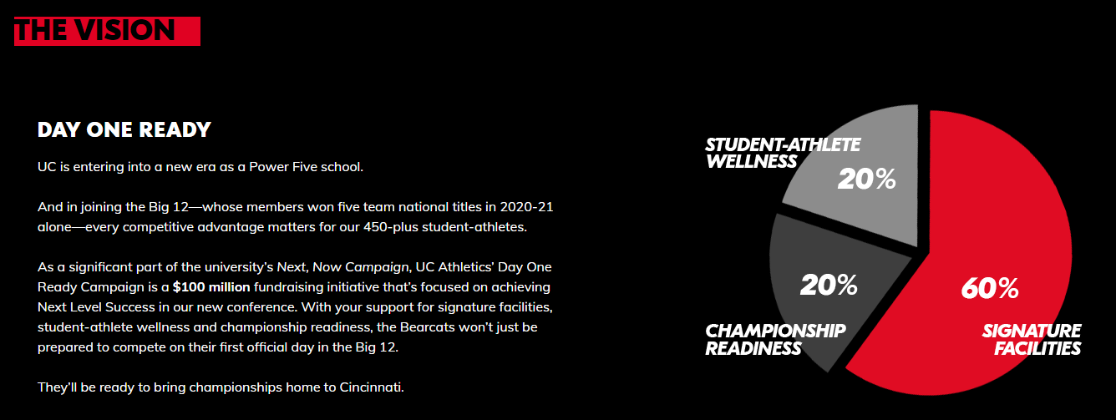

Slide 10


Slide 11
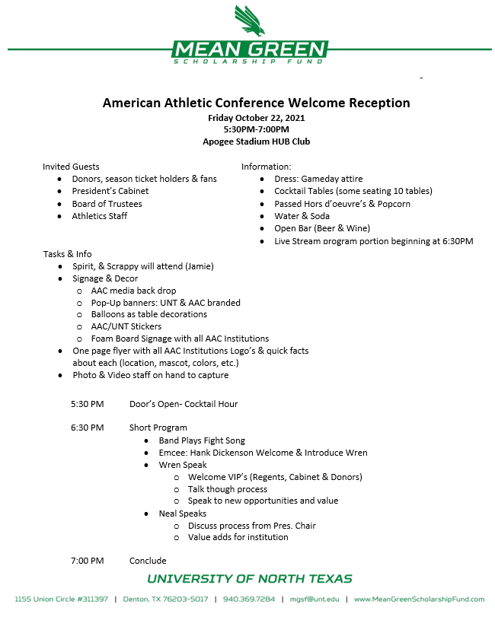
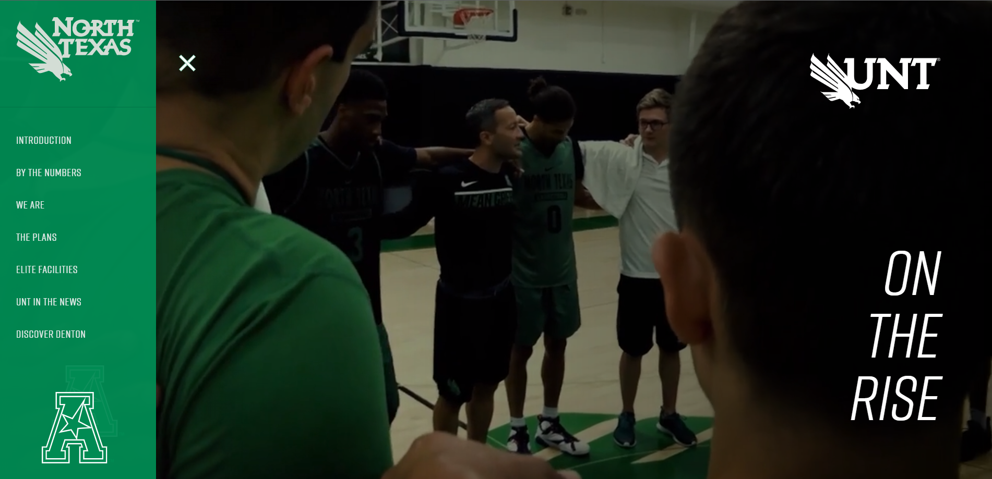
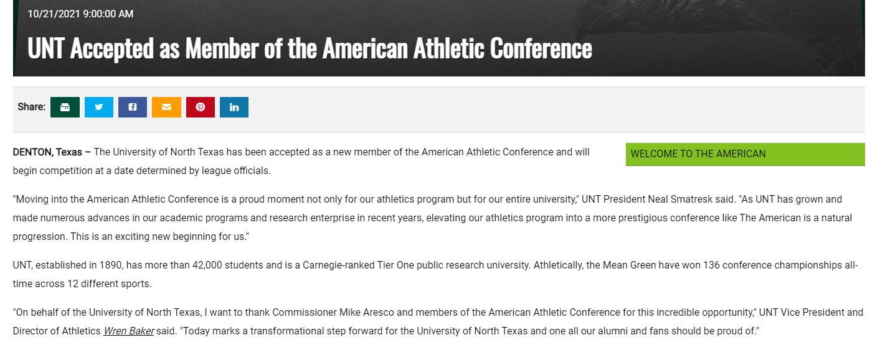

Slide 12


Slide 13
EVALUATING CHANGE
COMMUNICATION
IMPACT

Slide 14
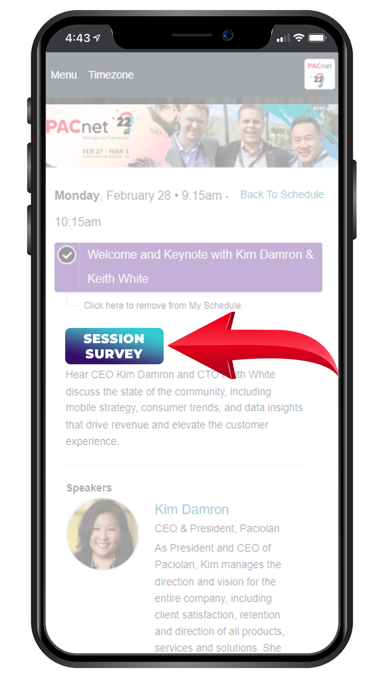
THANK YOU!
QUESTIONS?
Please complete the online session evaluation.

